Slide 1
Welcome to Year 2

Slide 2
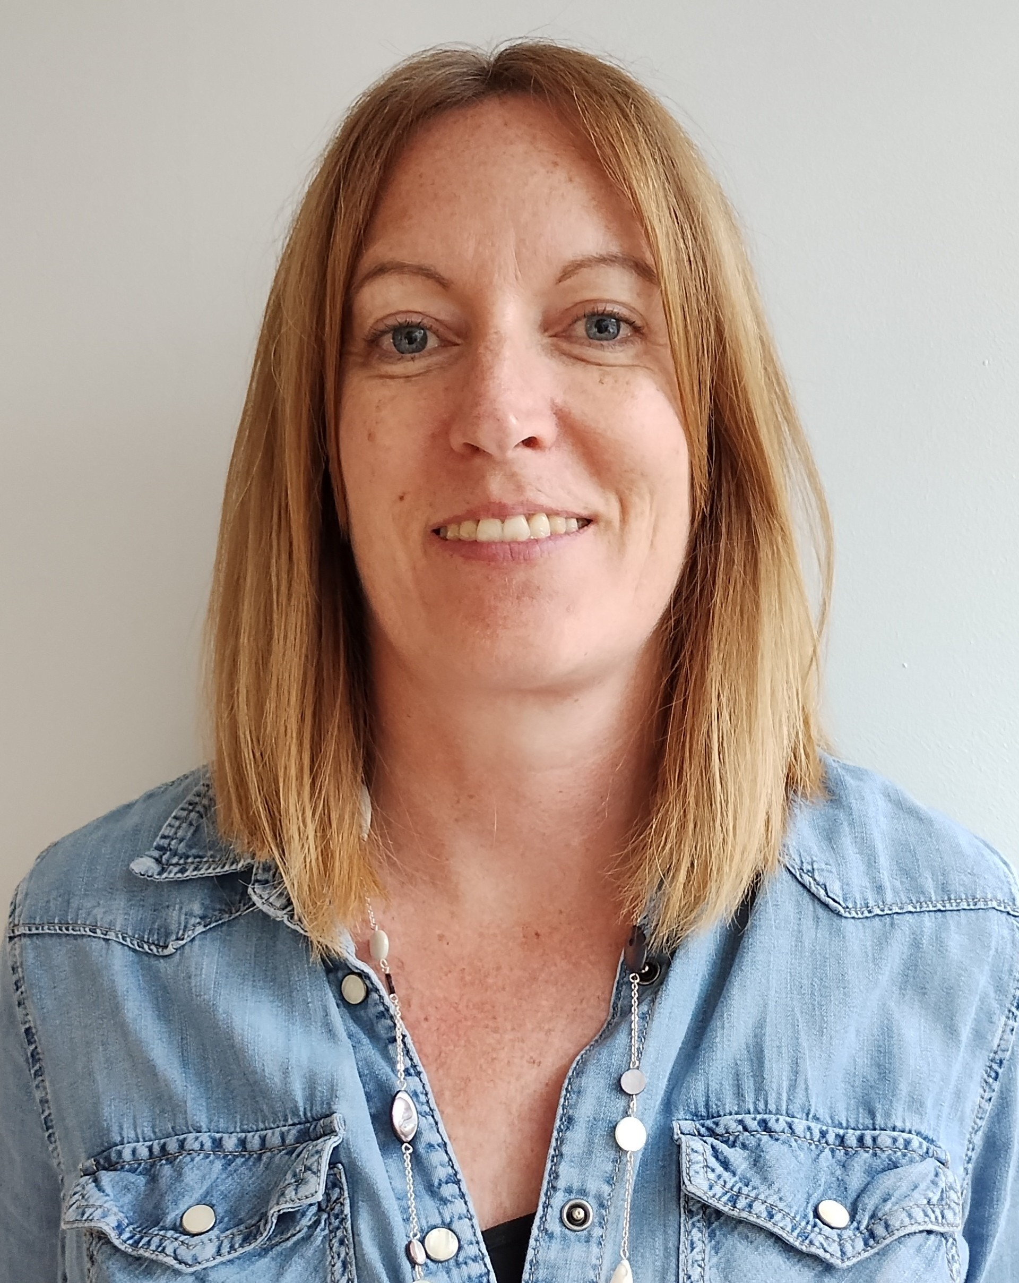
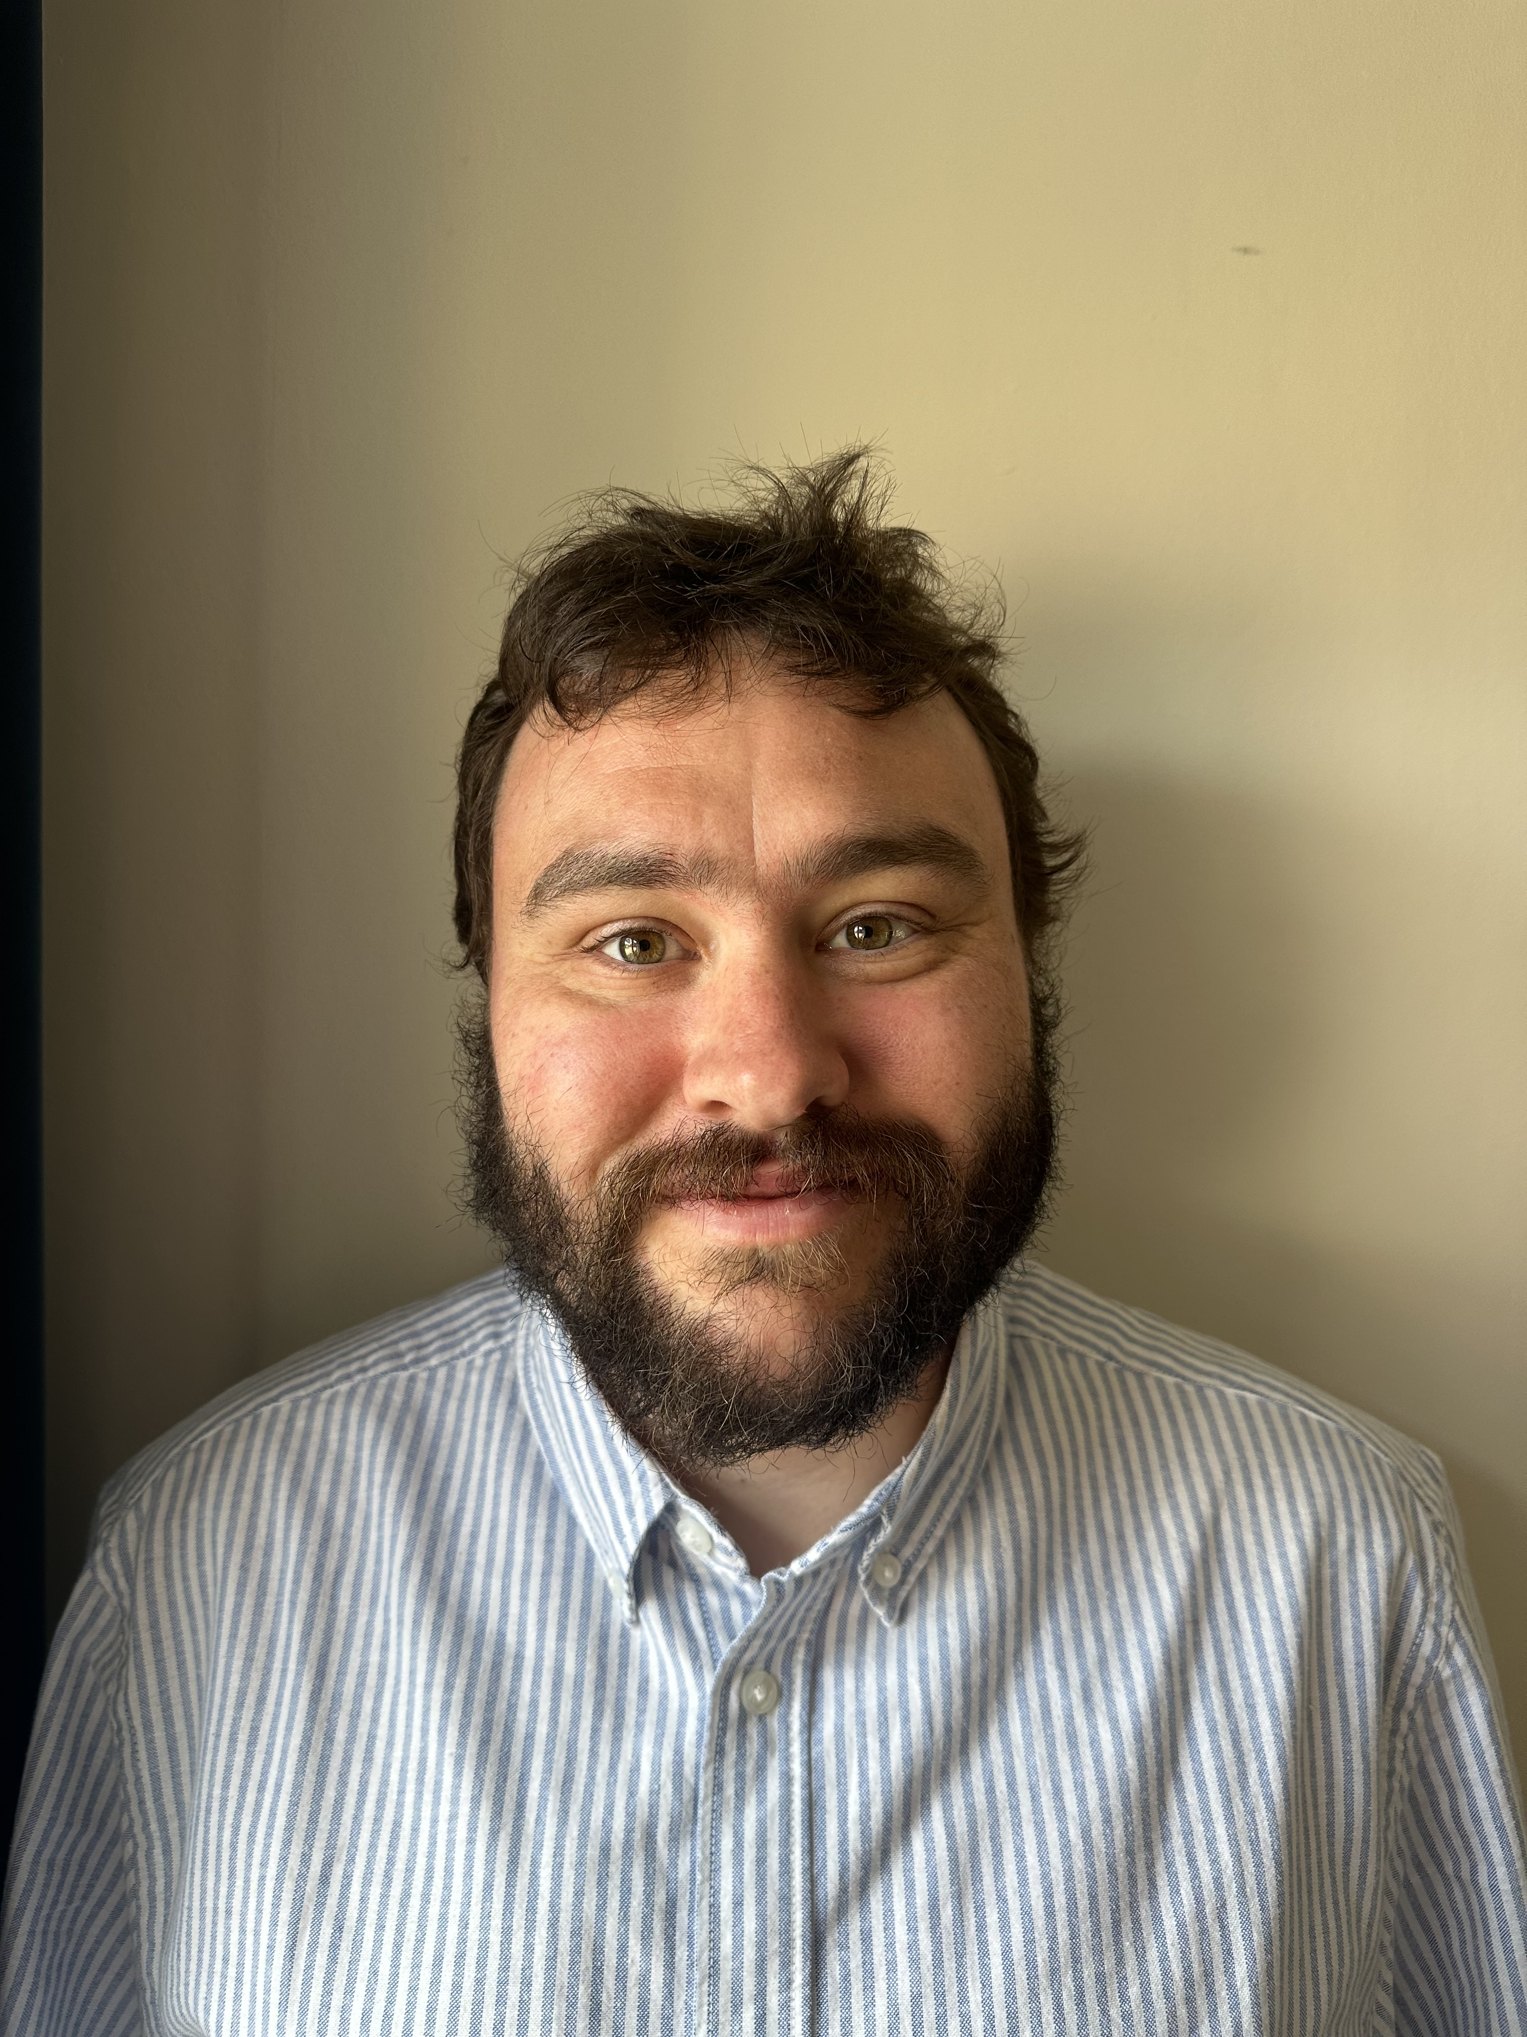
Meet the Team Hepworth Moore Mrs Calver Mrs Thompson Mr Stemp Mrs Barker
Mrs Butcher (1-to-1
Notes:
Please use your slide from July.

Slide 3
Agenda
Behaviour Expectations & School Values
Curriculum
Homework
Spellings
PE/Uniform
Assessments
Enrichment Opportunities
Attendance Matters
SEND Support
Questions/Parent Helpers
Notes:
Y1 – Please change to Y1 Phonics Screening Check
Y2 – Please change to Y2 Optional SATs (we complete these as every other YG does a generic termly test, they are no longer fed to the Gov)
Y6 – Please change to Y6 SATs

Slide 4
Behaviour Expectations
House points
Head Teacher Award
3 reminders
Restorative conversations
Involving parents
The Nook
Notes:
We award HP and have a Headteacher Award – currently focussed on writing achievements.
1-2-3 reminders
Therapeutic approach – respond to the child. We recognise when a child is dysregulated and will use our restorative conversation mat to talk through behaviours. (Please show this in the session – every classroom should have one.)

Slide 5
Behaviour Expectations
Be safe
Be respectful
Notes:
Explain that we are reviewing our behaviour policy but we will have these core values at heart.

Slide 6
School Values
Be caring
Be resilient
Be excellent

Slide 7
Curriculum
We are in the process of developing our wider curriculum this year.
We are now using a resource called KAPOW for many of our Foundation Subjects. We will still be using Purple Mash for Computing, Access Art and our PE curriculum is developed by Mr Mikelson and the use of GetSet4Education.
Our humanities topics include:
Autumn: World Jigsaw and Explorers and Adventurers

Slide 8
Homework
We would also like the children to use Times Tables Rockstars & Numbots to ensure they have a firm knowledge of their 2, 5 and 10 times tables.
We will provide links to Read Write Inc phonics resources to support your children’s learning at home.
Please read daily with and to your children, books will be sent home as soon as possible but latest from next week
Notes:
Y1/2 – same as Y4 but numbots subscriptions will be purchased for the children to use at home instead.
Y3 and 4 are the same.
Y5 and 6 – reading, spellings, arithmetic and alternate comprehension and grammar activities

Slide 9
Phonics - Read Write Inc
We are now using the phonics programme Read, Write Inc. As part of this, your child will start to bring home a phonics book.
The phonics book will be matched to the sounds which your child has been assessed to need to practice.
For the next four weeks, if you find that the book seems slightly on the easier side for your children, this is because we are working on your child's fluency and them being able to read the text without sounding out most words, beginning to add expression and intonation.
Following the initial four weeks, your child will be re-assessed and their book will then be even more closely matched to your child's phonics stage.
Notes:
Y1/2 – HFW
Y3/4 – same
Y5/6 – your list

Slide 10
Phonics - Read Write Inc
How to get the most out of reading a phonics book with your child:
Praise, praise, praise - focus on the positives and praise your child for their effort.
Timing - aim for your child to read for at least ten minutes, rather than an amount of pages, they do not need to finish the book in one sitting.
3 reads - your child should read their phonics book three times over the course of a week:
First read - for decoding the words (sounding them out, becoming familiar with them)
Second read - for fluency (to read at sentence level, rather than individual words)
Third read - for comprehension (to understand the text)
Notes:
Y1/2 – HFW
Y3/4 – same
Y5/6 – your list

Slide 11
Spellings – Y2 Statutory List
In addition to the weekly spelling lists, we would like the children to build their knowledge of the Y2 statutory spelling list.
The Y1 HFW should also be practised if these still pose a challenge to your child.
Dictations are a way to practise writing spelling words in a whole sentence and are used regularly within school – they are a great way to learn at home too. We encourage you to make them as silly as possible to engage your children!
Notes:
Y1/2 – HFW
Y3/4 – same
Y5/6 – your list

Slide 12
PE and Uniform
Thursday afternoons
Children should arrive at school in their school uniform and then get changed into their PE kit at lunch time.
School logo t-shirt or in colder months plain navy or black tracksuit tops or jumpers.
White socks and plain, black trainers for outdoor PE.
Hair should be tied back, earrings taken out, nails short.
When piercing ears, please wait until the holidays as the children will not be able to take part in lessons until they can remove their earrings independently.
No Smart watches – or watches that can receive messages/access the internet to be worn at any time.

Slide 13
Assessments
In Year 2, we complete NFER assessments termly. These cover a range of multiple choice and short answer questions.
We also include mock SATs for Y2 based on previous year papers.
These are used to inform teacher practice and the scores are not shared with the children.

Slide 14
Enrichment Opportunities
We believe learning beyond the classroom are extremely important.
These can be visits, workshops and whole school themed days.
We are in the process of finalising these for the year.
Notes:
3.3

Slide 15
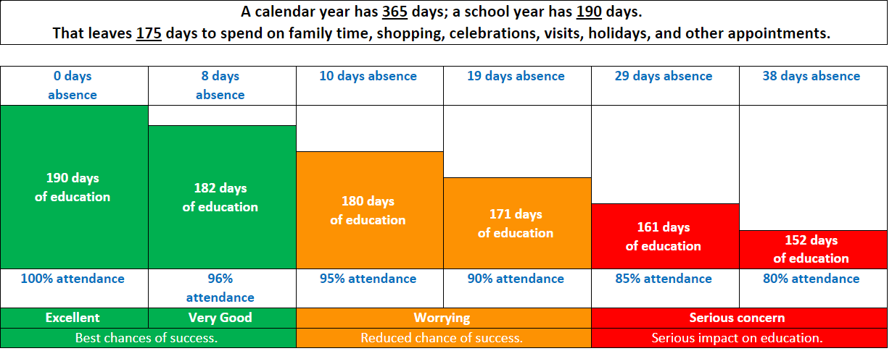
Attendance Matters
Notes:
Please reiterate the importance of attending school. Medical reasons for not being in school should be reported by 9am.
Explain that we have a term time absence form for planned absences. Holidays are generally not authorised and we must follow the government’s rule of imposing penalty notices. These have been upped to £80 per child, per parent (including step-parents). Any information for attendance and absences can be found on the website.

Slide 16
SEND Support
What do we mean by SEND?
SEND stands for Special Educational Needs and/or Disabilities.
A child has SEND if they have a learning difficulty or disability that calls for special educational provision to be made for them.
What should I do if I think my child has special educational needs and/ or a disability?
The first person to speak to is your child's class teacher. They will be able to discuss support for your child and to signpost you to any helpful resources. You can also find information about SEND at our school in our SEND Information Report on our school website.
Support from the SENDCo
If your child's class teacher thinks that it would be helpful to get specialist advice, they will discuss your child's needs with the SENDCo.
The Interim SENDCo is Jen Gregson, standing in for Mrs Hannah Paradis during her maternity leave. Miss Gregson can be contacted via the SEND email address: sendco@bassingbourn.cambs.sch.uk.

Slide 17
Contact
You can make an appointment to see us through the Office.
You can email us, but please do not email with something that needs attention on that day – we do not check our emails during school hours. You can find class email addresses on the website. If you receive no response after 48 hours, please contact the office.
2Hh@bassingbourn.cambs.sch.uk - Hepworth
2Me@bassingbourn.cambs.sch.uk - Moore
Notes:
3.1

Slide 18
Questions
We would really welcome parent helpers in school. If you would like to volunteer, please talk to the Office.

